Slide 1

Section 11.3 The Integral Test and Estimates of Sums
Lecture 2
Integrals and Series Remainders

Slide 2
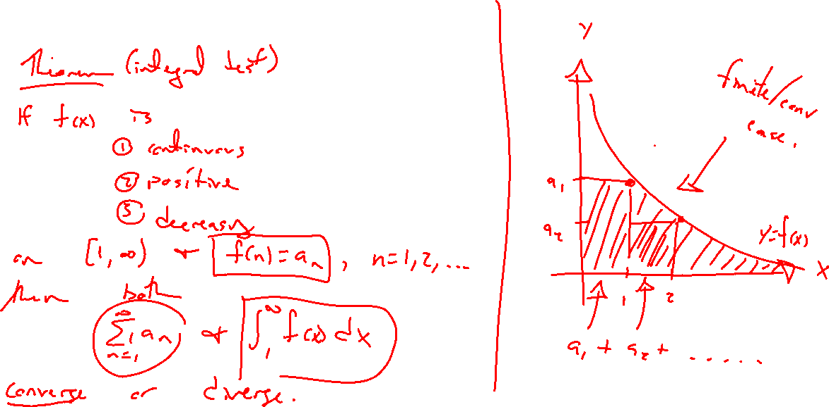
Integral Test
Notes:
Theorem statement / graph idea
Only says converge / diverge
Note that the entire series can be drawn inside the integral area

Slide 3
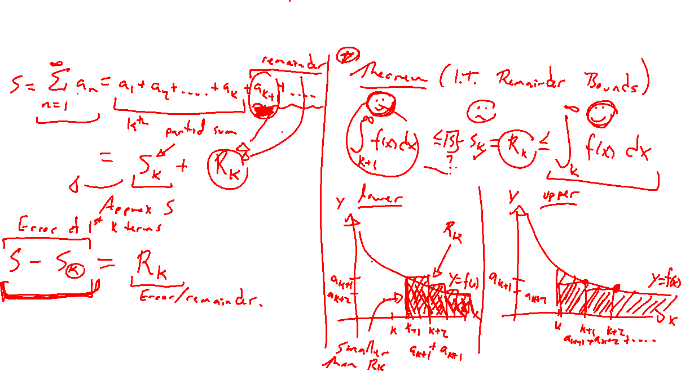
Integral Series Remainder Estimate
Notes:
Break sum as S_n + a_{n+1} + a_{n+2} + …
Remainder after the nth partial sum can be placed inside of \int_n^{\infty} f(x)~dx and outside \int_{n+1}^{\infty} f(x)~dx

Slide 4
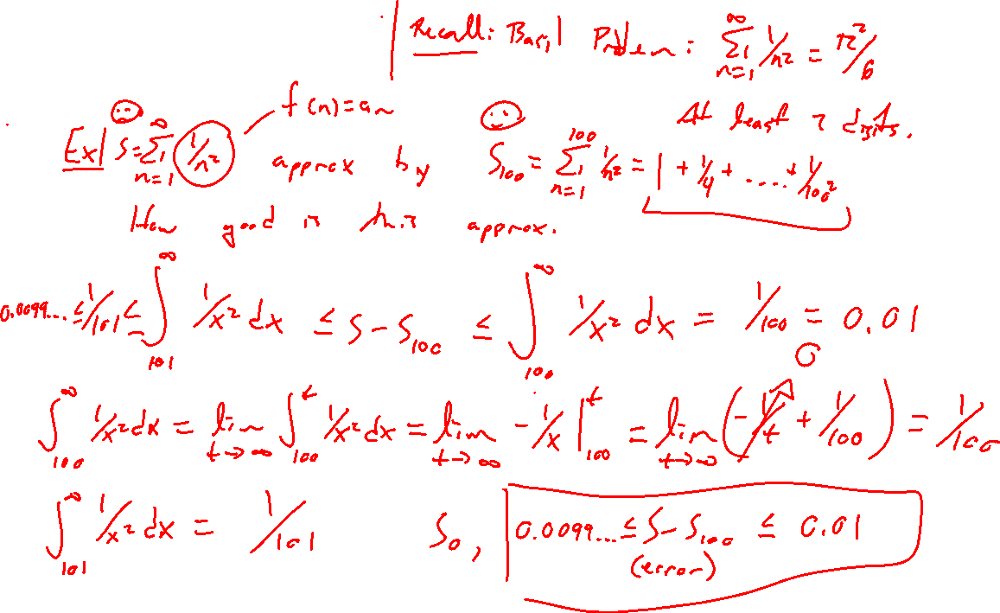
Example
Notes:
How close is the S_100 to the true sum of 1/n^2
Recall sum is known from Basil problem: pi^2/6
Use desmos to verify

Slide 5
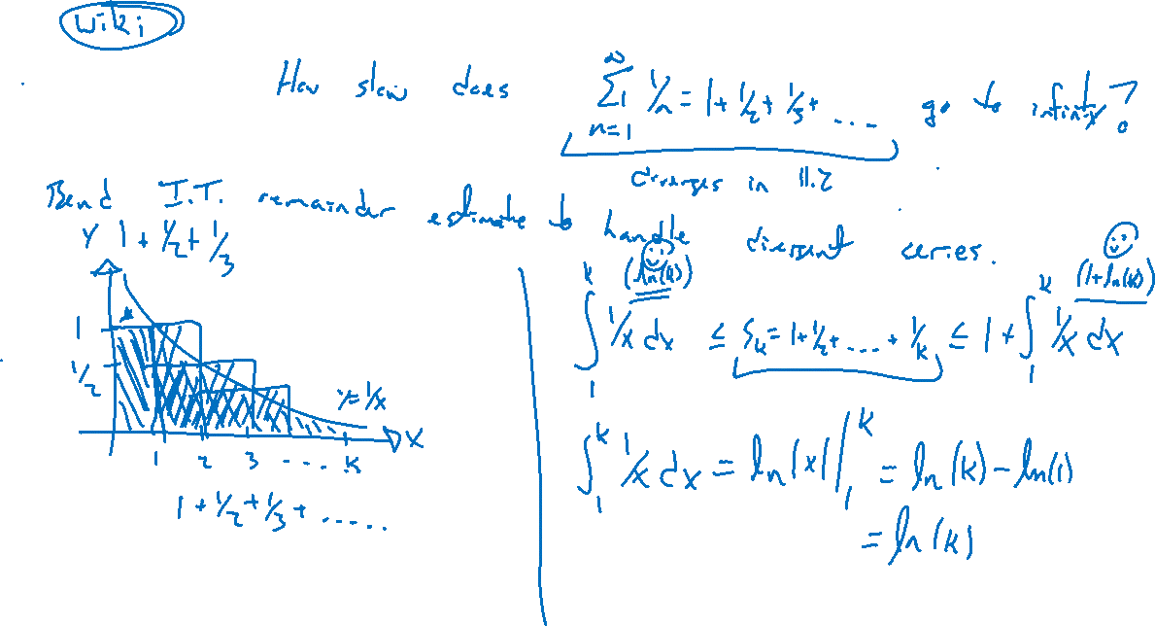
Example
Notes:
Roundabout application.
Bound harmonic series 1+½+…+1/n above by 1 + \int_1^n 1/x~dx <= 1+\ln(n)
Consider then 1000 terms, 100000. Use desmos to illustrate.

Slide 6
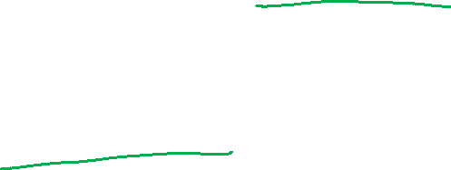
Section 11.3 Examples and Homework
Rework textbook examples: 1, 3, 4, 5, 6
Write down problem.
Close book and attempt on own.
Compare your solution to text solution, improve your writing.
Exercises: 5, 7, 15, 23, 29
Notes:
Roundabout application.
Bound harmonic series 1+½+…+1/n above by 1 + \int_1^n 1/x~dx <= 1+\ln(n)
Consider then 1000 terms, 100000. Use desmos to illustrate.

Slide 7

Section 11.3 Homework Submission to Canvas
Preview of section​
Skim section, write short paragraph summary, list all important definitions / theorems / formulas.​
Notes on video lectures​
Include all details, worked examples, your own thoughts​
Worked examples from text​
Solutions to exercises​
Final reflection of section​
List of key takeaways to remember​

